Slide 1
Smart security door lock with pin access
Joel Mangalam Omega ID: A366

Slide 2
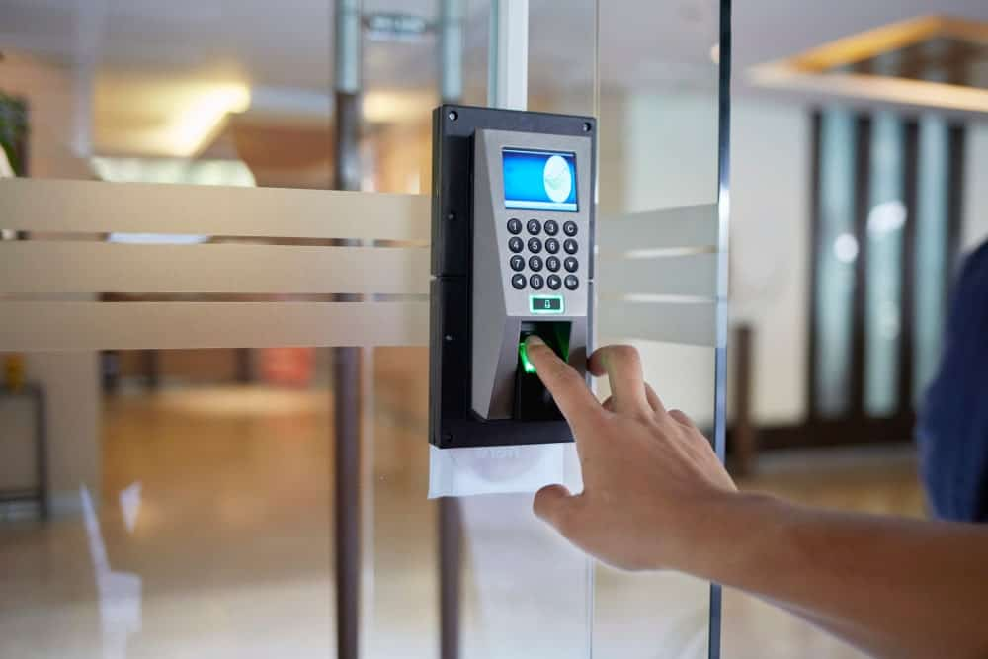
Project goals
Improve security of a door lock system.
Access a door only through password.
Send SNS notification to mobile and email over AWS IOT

Slide 3
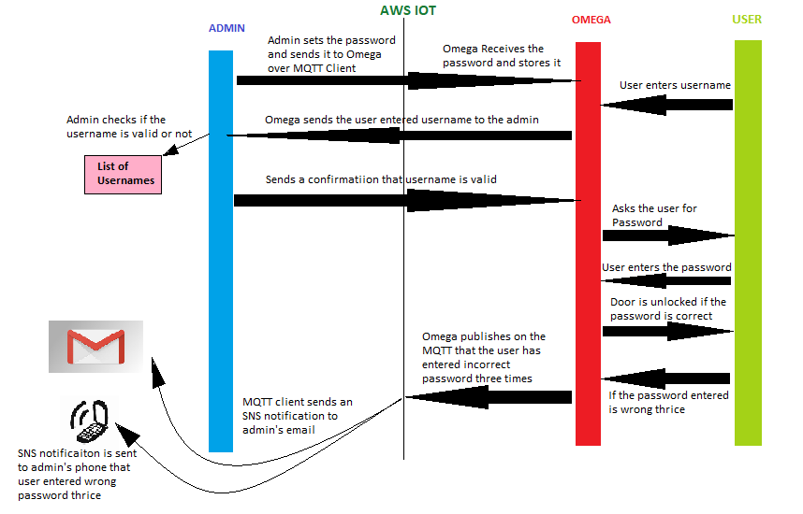

Slide 4
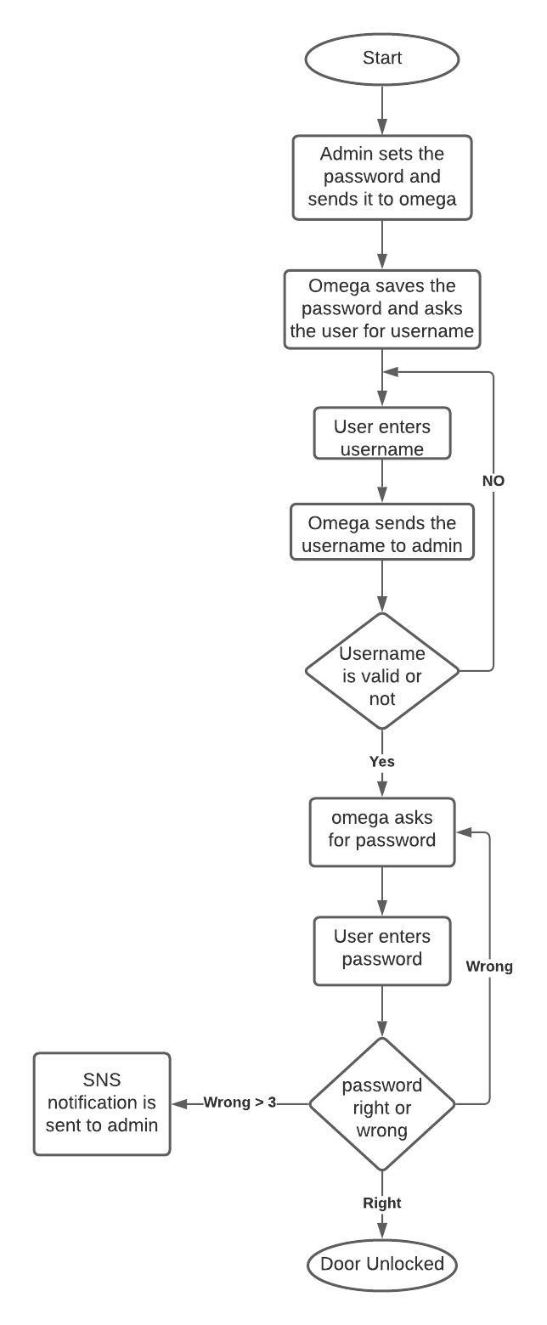

Slide 5
Thank YOU

